Slide 1


Slide 2
exchanged
trudged
advised

Slide 3


Slide 4
adoringly
sheepishly
reluctantly

Slide 5


Slide 6
swayed
terrifying
performer

Slide 7


Slide 8
evenly
tramping
dodging

Slide 9


Slide 10
harsh
charming
clever

Slide 11
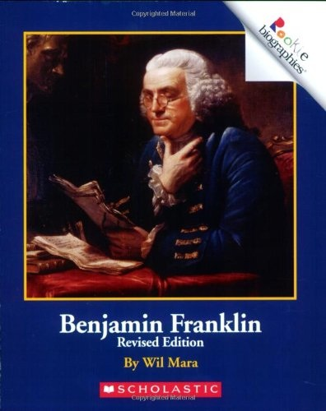

Slide 12
correctly
improvements
inventions

